Slide 1
Search Algorithms: Object-Oriented Implementation (Part D)

Slide 2
Contents
Conventional vs. AI Algorithms
Local Search Algorithms
Implementing Hill-Climbing Algorithms
Defining ‘Problem’ Class
Adding Gradient Descent
Defining ‘HillClimbing’ Class
Adding More Algorithms and Classes
Experiments
Goal: Implement a HillClimbing class that integrates multiple Search Algorithms into a single unit!

Slide 3
Summary of Implementation So Far
Search Algorithm (C) / Search Tool v2 Implementation Status
  problem.py : Definition of the class for variables/functions related to the problem's solution.
    Problem Class definition : Includes content common regardless of the problem type (e.g., saving the solution, saving numEval, etc.)
    Defines two subclasses based on the problem type, and defines information and frequently used functions related to each problem:
      Numeric Class (inheriting from Problem)
      TSP Class (inheriting from Problem)
  And, the solution algorithms for solving problems are each implemented in separate files.
    Separate source code and main function are defined according to the solution algorithm used to solve the problem
    Implementation code for solution algorithms to solve Numerical Optimization problems:
      steepest ascent (n).py : Code to solve Numeric problems using the SA method
      first-choice (n).py : Code to solve Numeric problems using the FC method
      gradient descent.py : Code to solve Numeric problems using the GD method
    Implementation code for solution algorithms to solve TSP problems:
      steepest ascent (tsp).py : Code to solve TSP problems using the SA method
      first-choice (tsp).py : Code to solve TSP problems using the FC method
Today’s Topic

Slide 4
Code Improvement Idea
Search Algorithm (C) - Search Tool v2 drawbacks
  Each solution algorithm is implemented with a separate main program (source code).
  To run a specific algorithm, the corresponding program must be found and executed.
  If a new solution algorithm is added, a new program and new source code are required.
    Ex: To add the Gradient Descent algorithm, a new gradient descent.py source code was created and implemented.
Idea for Improvement
  Integrate the implemented solution algorithms from different source codes into one main program (= one source code) and allow the user to select the solution algorithm during program execution!
steepest ascent (n).py
main.py
first-choice (n).py
gradient descent.py
steepest ascent (tsp).py
Algorithm integration
first-choice (tsp).py

Slide 5
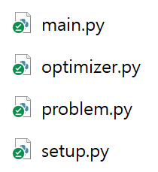
Code Improvement Idea
Search Algorithm (C) Search Tool v2: Implementation Method to v3
  Source code structure:
    main.py : Receives user input, selects the Problem Type and the Solution Algorithm
    problem.py : Code definition related to the Numeric and TSP problems.
    optimizer.py : Definition of the classes and methods (functions) for the solution algorithm implementation.
    setup.py : Definition of the functions and management of information commonly used by the Problem class and the HillClimbing class.
  Class structure change:
    Extract the common information/attributes used by the existing Problem class and the newly defined HillClimbing class, define them in a separate Setup class, and modify the code so that both the Problem class and the HillClimbing class inherit from it.
  Class for solution algorithms : optimizer.py
    Implement the class HillClimbing, and define the respective SteepestAscent, FirstChoice, and GradientDescent classes that inherit from it.
  Main program: main.py
    Write a single main program and allow the user to select simultaneously via user input:
      (1) Which problem to solve (Numeric or TSP), and
      (2) Which solution algorithm to use (SA, FC, GD).

Slide 6
Search Tool v3
Search Algorithm (D) / Search Tool v3 Implementation details
  Implementation of the top-level Setup class to store delta, alpha, and dx values.
    The Problem class (for problems) and the HillClimbing class (for solution algorithms) will both inherit from the Setup class.
    delta : Used when generating mutants (= neighbor solution) in the Numeric Optimization problem type.
    alpha : Determines the step size or learning rate in the Gradient Descent solution algorithm.
    dx : Used when calculating the gradient in the Gradient Descent solution algorithm.
  problem.py : Defines and differentiates classes based on the nature of the problem.
    Definition of the Problem class (inheriting from Setup).
    Definition of the Numeric class (inheriting from Problem).
    Definition of the TSP class (inheriting from Problem).

Slide 7
Search Tool v3
Search Algorithm (D) / Search Tool v3 Implementation details
  optimizer.py : Defines and differentiates classes according to the solution algorithm used to solve the problem
    Definition of the HillClimbing class (inheriting from Setup).
    Defines the SteepestAscent class (inheriting from HillClimbing) and implements the class using the code previously implemented in steepest ascent (n.tsp).py.
    Defines the FirstChoice class (inheriting from HillClimbing) and implements the class using the code previously implemented in first-choice (n.tsp).py.
    Defines the GradientDescent class (inheriting from HillClimbing) and implements the class using the code previously implemented in gradient descent.py.
  main.py: Implements the user interface (UI) so the user can make selections during program execution.
    Select which type of problem to solve: Numeric or TSP class.
    Select which solution algorithm to use for the chosen problem: SteepestAscent, FirstChoice, or GradientDescent class.
    Note: Logic is required to prevent the user from selecting the Gradient Descent algorithm in the case of a TSP problem.

Slide 8
Defining ‘HillClimbing’ Class
We define HillClimbing class to put together all the search algorithms (optimizer.py) and unite all the programs into a single main program (main.py)
  Search algorithms become subclasses under HillClimbing
  The class hierarchy of HillClimbing is stored in a separate file named ‘optimizer.py’
The names of the search algorithms are now the names of the subclasses under the HillClimbing class
  The body of each search algorithm becomes the body of the run method of the corresponding subclass
The HillClimbing class that integrates the Search algorithms into one (For reference, the Problem class stores information about what problem is being solved).
HillClimbing
SteepestAscent
FirstChoice
GradientDescent

Slide 9
Defining ‘HillClimbing’ Class
To have a single main program, we need a new user interface to ask the user the type of problem to be solved (pType) and the type of algorithm to be used (aType) [pType, aType is int datatype]
  These information will be used to create the Problem (= Numeric or Tsp) and HillClimbing (= SteepestAscent, FirstChoice or GradientDescent) objects of the right types
  pType will also be used when printing out messages about the settings of the search algorithm used
displaySetting that was previously part of the main program is moved to the HillClimbing class
  because what it displays are the information about the settings of the search algorithms that are now the methods of HillClimbing

Slide 10
Defining ‘HillClimbing’ Class
To store information necessary for displaySetting and the search algorithms, two variables are defined in HillClimbing
  pType: integer indicating the type of problem to be solved
  limitStuck: maximum evaluations allowed without improvement
    Previously, it was LIMIT_STUCK
    Currently, only firstChoice is under the control of this variable
    Later, the stochastic hill-climbing algorithm to be added to the search tool will be controlled by this variable
displaySetting in HillClimbing prints out the mutation step size (delta) when the type of problem is numerical optimization
  This method is inherited to SteepestAscent and FirstChoice, but not to GradientDescent

Slide 11
Defining ‘HillClimbing’ Class
displaySetting in each class of search algorithm prints out the algorithm name and additional setting information specific to that algorithm
  displaySetting of FirstChoice prints out the maximum evaluations allowed without improvement (limitStuck)
  displaySetting of GradientDescent prints out the values of alpha and dx (using accessor methods getAlpha / getDx or they can be directly accessed via self._alpha / self._dx)
Notice that delta, alpha, dx were variables of Numeric subclass (under Problem), and getDelta, getAlpha, getDx were methods of Numeric
  For displaySetting to refer to alpha and dx, it needs as its argument the problem instance being solved (so that it can use the statement such as p.getAlpha())
  다음 페이지 계속...

Slide 12
Defining ‘HillClimbing’ Class
What if we make alpha and dx variables of GradientDescent, and delta a variable of HillClimbing?
  Not a good idea because they are already variables of the subclass Numeric
We better create a superclass of Numeric and HillClimbing, and have those variables belong to that superclass
  Once this is done, the three accessors, getDelta, getAlpha, and getDx of the Problem class are no longer necessary because displaySetting that deals with these information will belong to HillClimbing and thus can access those variables directly
  다음 페이지 계속...

Slide 13
Adding a Superclass ‘Setup’
Since delta, alpha, and dx are needed by both the classes HillClimbing and Problem, we define a new class named Setup to hold those variables and make it a parent class of both
We store Setup in a separate file named ‘setup.py’ and let the ‘problem.py’ and ‘optimizer.py’ files import it from that file
Setup
Also, the getDelta, getAlpha, and getDx methods that were previously in problem.py are moved to the Setup class.
delta
alpha
dx
Problem
HillClimbing
pType
limitStuck
Numeric
Tsp
expression
domain
numCities
locations
distanceTable

Slide 14
The Main Program
The main program is stored in a file named ‘main.py’
  The ‘main.py’ file should import everything from ‘problem.py’ and ‘optimizer.py’
The main program includes a few functions for a new user interface to ask the user to choose the problem to be solved and the optimization algorithm to be used
Receive pType information as input to determine which type of problem to solve (Numeric Opt or TSP).
Receive aType information as input to determine which algorithm to use (Steepest Ascent or First Choice or Gradient Descent).

Slide 15
The Main Program
main.py is comprised of the following four functions:
1. main():
  Creates a Problem object p of the right type by querying to the user (selectProblem)
  Creates a HillClimbing object alg (search algorithm) by querying to the user (selectAlgorithm)
  Runs the search algorithm by calling the run method of the HillClimbing class (alg.run)
  Shows the specifics of the problem just solved (p.describe)
  Shows the settings of the search algorithm (alg.displaySettings)
  Displays the result of search (p.report)

Slide 16
The Main Program
2. selectProblem():
  Asks the user to choose the type of problem to be solved
  Creates a Problem object p of the right type
  Sets the variables of the corresponding subclasses of Problem
  Returns p and pType (an integer indicating the problem type)
3. selectAlgorithm(pType):
  Asks the user to select a search algorithm
  Asks the user to select again if gradient descent is chosen for a TSP (invalid)
  Prepares a dictionary whose keys are integers corresponding to aType, and values are the names of the subclasses of HillClimbing (i.e., search algorithms)
  Creates an object alg of the targeted HillClimbing subclass using the dictionary (alg = eval(optimizers[aType]))
  Sets the variables of the HillClimbing class
  Returns alg

Slide 17
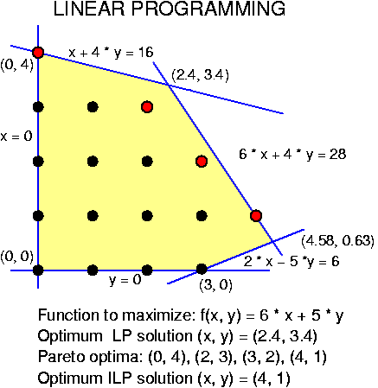
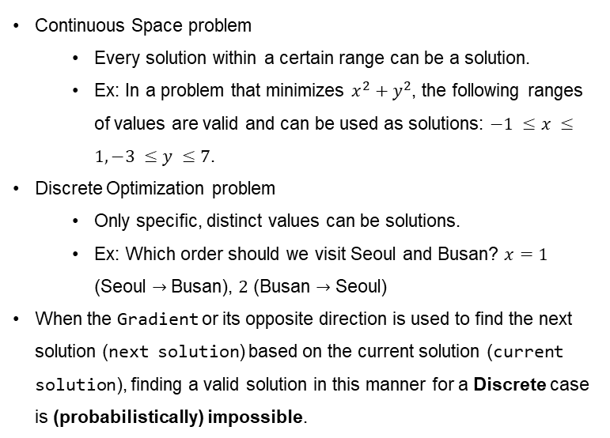
The Main Program
4. invalid(pType, aType):
  If gradient descent is chosen for a TSP (= 잘못된 선택), informs the fact to the user and returns True
  Otherwise, returns False
The Gradient Descent algorithm can only solve problems of the Continuous Space type and cannot be used for Discrete type TSP problems.
Continuous Space problem
  Every solution within a certain range can be a solution.
  Ex: In a problem that minimizes $x^{2}+y^{2}$, the following ranges of values are valid and can be used as solutions: $−1 ≤x ≤1, −3 ≤y ≤7$.
Discrete Optimization problem
  Only specific, distinct values can be solutions.
  Ex: Which order should we visit Seoul and Busan? $x=1$ (Seoul $→$Busan), $2$ (Busan $→$ Seoul)
When the Gradient or its opposite direction is used to find the next solution (next solution) based on the current solution (current solution), finding a valid solution in this manner for a Discrete case is (probabilistically) impossible.
http://www.cse.chalmers.se/edu/year/2011/course/TDA206_Discrete_Optimization/

Slide 18
Order of operation
main.py > main()
  Call selectProblem()
    Receive Problem Type input form the user (1=Numeric, 2=TSP) => store as pType
    Based on pType, create Numeric or TSP class instance => store in variable p
    Call p.setVariables
      Receive the file name where the problem is stored from the user.
      Read the stored file, extract the problem information, and store it in the class's instance variables.
  Call selectAlgorithm(pType)
    Receive input from the user for which algorithm to use (1: SA, 2: FC, 3: GD) => store as aType
    Call the invalid function to check (e.g. TSP cannot be solved by GD)
    Create a class instance corresponding to the solution algorithm entered by the user => store in variable alg
  alg.run(p) to execture solution algorithm
    The implementation of alg.run is _identical to the content of the solution algorithm code_ previously implemented in the separate files.
  Output problem information, parameter information, and execution results (solution, etc.) to the screen by sequentially calling the functions: p.describe(), alg.displaySettings(), p.report().

Slide 19
Source Code (summary)
Source code structure
  main.py : Receives user input, selects the problem type and solution algorithm, and executes the algorithm.
    main, selectProblem, selectAlgorithm, invalid functions.
  problem.py : Defines code related to Numeric and TSP problems.
    Implementation: Problem class, Numeric class, TSP class.
  optimizer.py : Implements classes and methods (functions) for the solution algorithm implementation.
    HillClimbing Class: setVariables, displaySetting, run (pass) methods
    SteepestAscent Class: displaySetting, run, bestOf methods
    FirstChoice Class: displaySetting, run methods
    GradientDescent Class: displaySetting, run methods
    Implementation is the same as the solution algorithm code previously in separate files.
  setup.py : Defines functions and manages information commonly used by the Problem class and the HillClimbing class.
    Implementation: getDelta, getAlpha, getDx

